Slide 1
Network Layer

Slide 2
OSI network layer
OSI model layer 3
TCP/IP model Internet layer
Application
HTTP, FTP, TFTP, SMTP etc
Presentation
Data stream
Application
Session
Transport
Segment
TCP, UDP
Transport
Network
Packet
IP
Internet
Data link
Frame
Ethernet, WAN technologies
Network Access
Physical
Bits

Slide 3
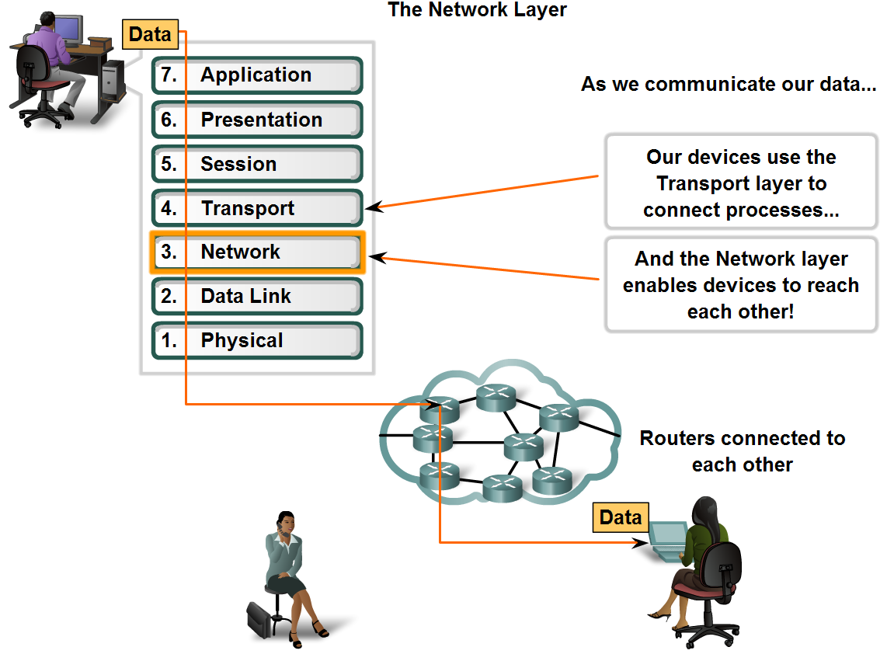
Network Layer
Provides services to exchange the individual pieces of data over the network between identified end devices. .

Slide 4
Basic Processes Of Network Layer
Addressing
Encapsulation
Routing
Decapsulation

Slide 5
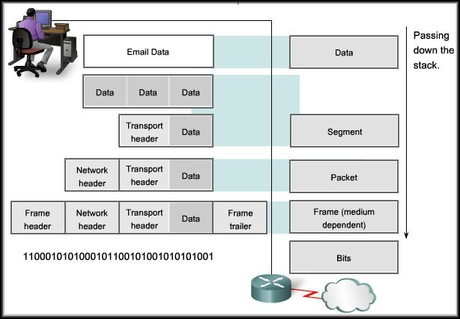
Network layer encapsulation
Segment from transport layer.
Packet header added to make IP packet.
Sent to data link layer for further encapsulation into a frame.

Slide 6
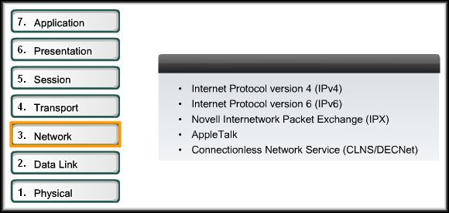
Network Layer Protocols
Internet Protocol Version 4 (IPV4) is the most widely used version of IP.
Only Layer 3 protocol used on the Internet.
Focus of this course.

Slide 7
The IP v4 and IP v6 Protocol
IP version 6 (IPv6) is developed and being implemented in some areas.
IPv6 will operate alongside IPv4 and may replace it in the future.
IP provides
  Services
  Packet header structure
  Contents
Which is specified by either IPv4 protocol or IPv6 protocol.
Notes:
These services and packet structure are used to encapsulate UDP datagrams or TCP segments for their trip across an internetwork.

Slide 8
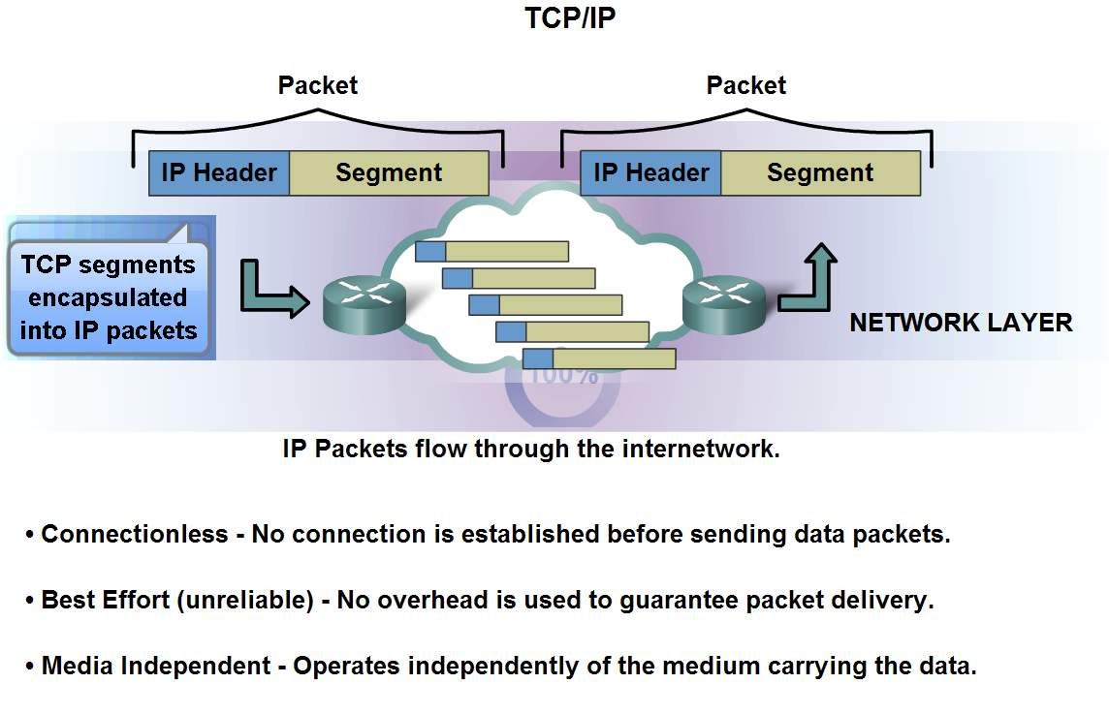
The IP v4 Protocol

Slide 9
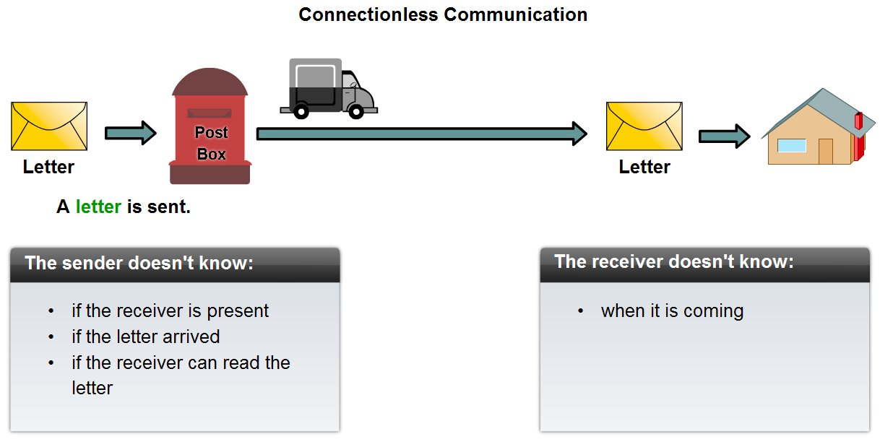
The IPv4 Protocol-Connectionless

Slide 10
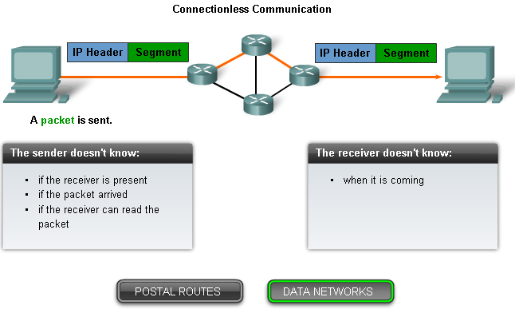
The IPv4 Protocol-Connectionless

Slide 11
The IPv4 Protocol-Best Effort
IP does not have the capability to manage, and recover from, undelivered or corrupt packets.
Protocols at other layers can manage reliability.
IP then can function very efficiently at the Network layer.

Slide 12
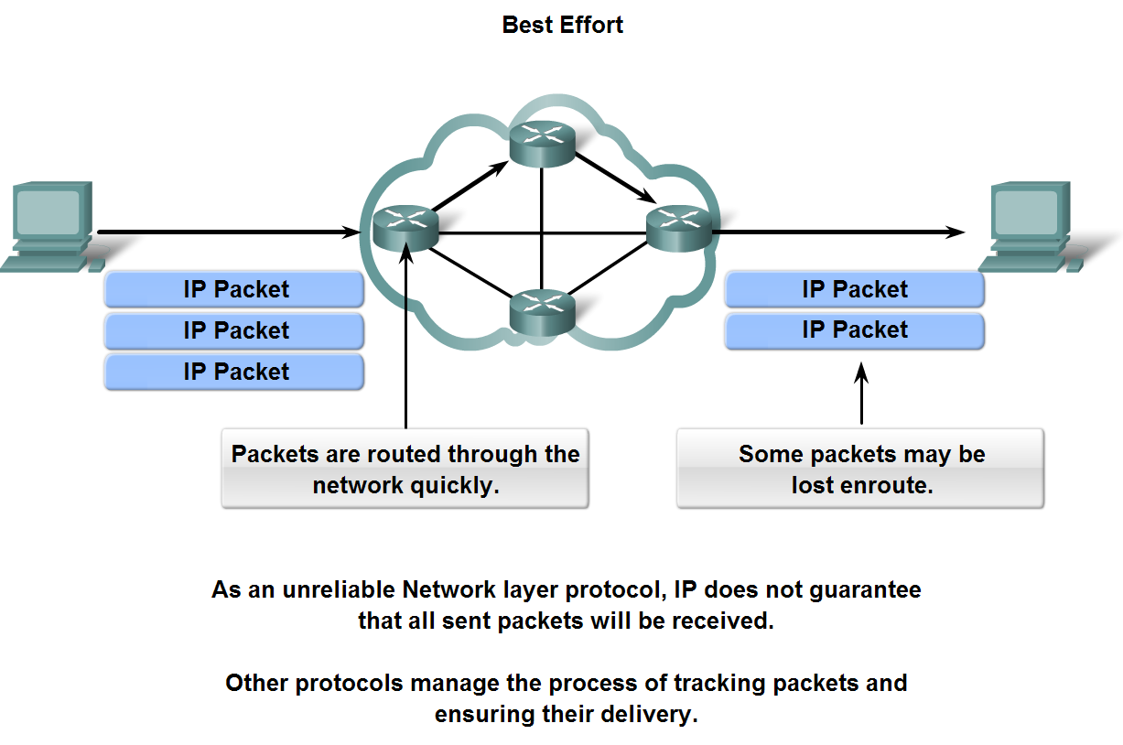
The IPv4 Protocol-Best Effort

Slide 13
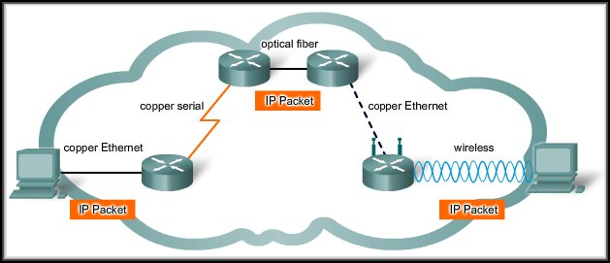
The IPv4 Protocol-Media Independent
The transport of IP packets is not limited to any particular medium. Except….

Slide 14
The IPv4 Protocol-Media Independent
One major characteristic of the media : Maximum Transmission Unit (MTU).
The Data Link layer passes the MTU upward to the Network layer.
In some cases, an intermediary device will need to split up a packet when forwarding with a smaller MTU.
This process is called fragmenting the packet or fragmentation.

Slide 15
Media Independent
Copper Ethernet: MTU = 1,518 bytes.
Copper Serial: Frame Relay MTU = 512 bytes.
Optical Fiber: ATM MTU = 17,966 bytes.
Wireless: 802.11 MTU = 2272 bytes.

Slide 16
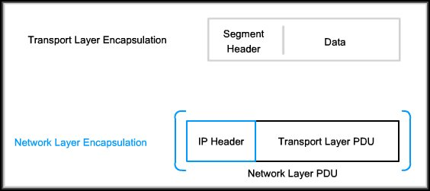
Packaging the Transport Layer PDU
In TCP/IP based networks, the Network Layer PDU is the IP Packet.

Slide 17
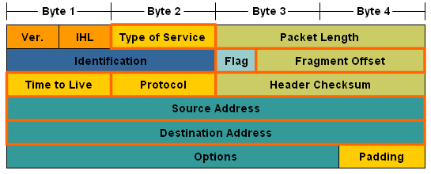
IPv4 packet header fields
IP address of source host, needed so reply can be sent.
IP address of destination host, needed so routers can find route.

Slide 18
IPv4 packet header fields
Reduced by 1 at each router. Packet dropped if it goes to 0.
TCP or UDP used in Transport layer.

Slide 19
IPv4 packet header fields
Priority for QoS. E.g. voice data has higher priority than e-mail.
For checking if header has been corrupted.

Slide 20
IPv4 packet header fields
Shows if packet has been fragmented or must not be fragmented.
If router has to split a packet, this gives order for putting pieces together.

Slide 21
IPv4 packet header fields
Version 4.
Header length.
Length of whole packet.

Slide 22
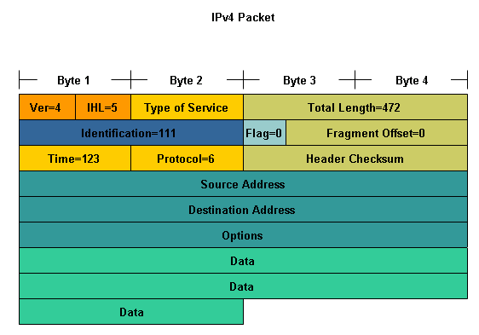
Typical IPv4 Packet

Slide 23
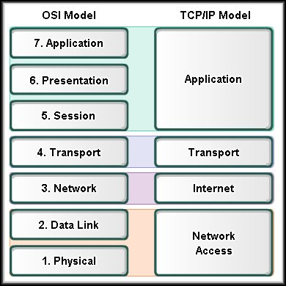
OSI Network Layer
Networks: Dividing Hosts into Groups

Slide 24
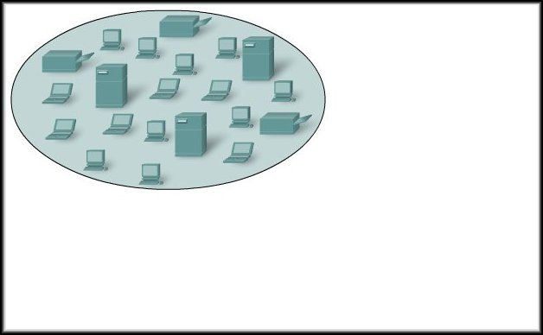
Dividing Hosts into Groups
As networks grow, they become too unwieldy to manage as a single entity.
Often, the solution is to divide the large network into several more manageable sub-networks.
The question is…..HOW?

Slide 25
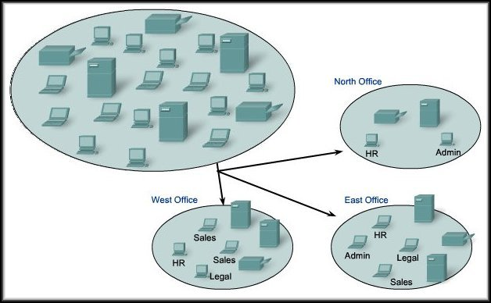
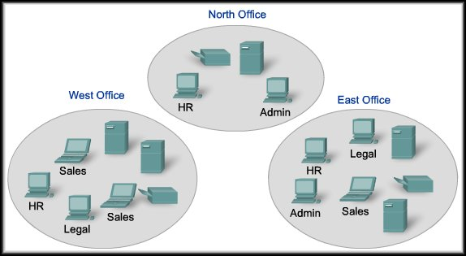
Dividing Hosts into Groups
Should it be divided geographically?

Slide 26
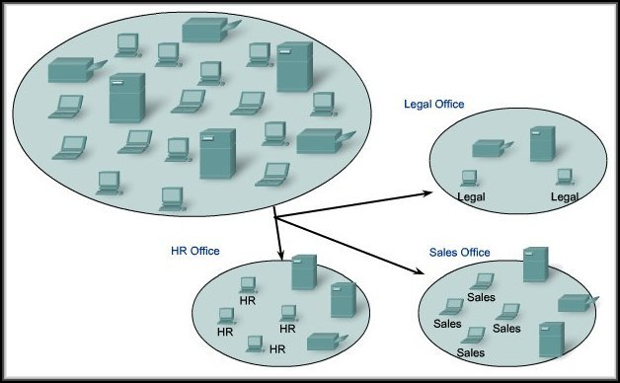
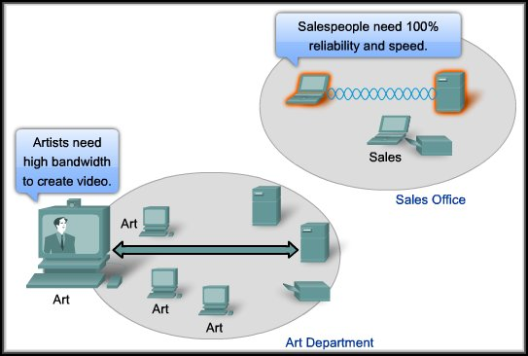
Dividing Hosts into Groups
Should it be divided based on purpose?

Slide 27
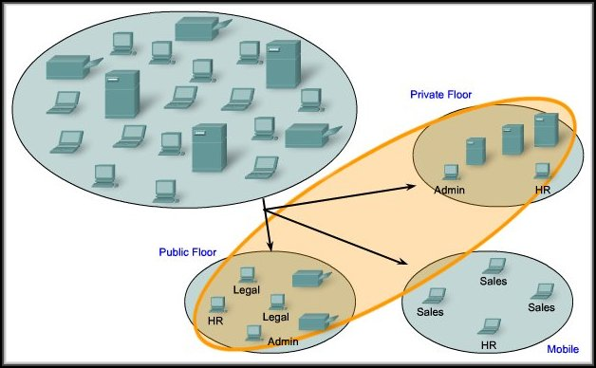
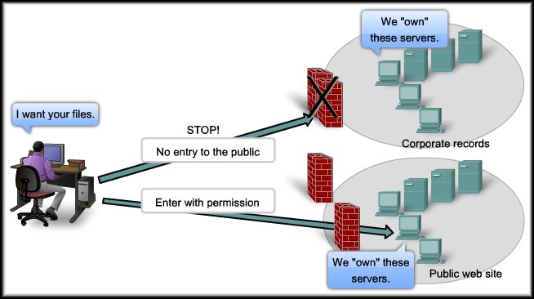
Dividing Hosts into Groups
Should it be divided based on ownership?

Slide 28
Why Separate Hosts into Networks?
Performance
Security
Address Management

Slide 29
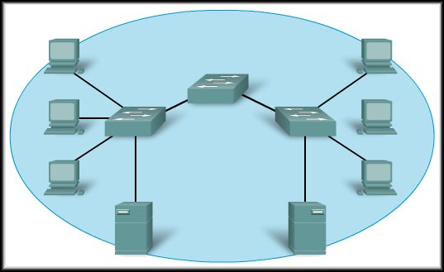
Performance
A
Large numbers of
hosts on a single
network:
  Actual Data
  Overhead
A big part of the
overhead is
broadcasts.
In this context, each network is called a broadcast domain.
Switches forward broadcasts to each device connected to a switch port.
If we can reduce broadcast overhead, it would improve performance on the network.

Slide 30
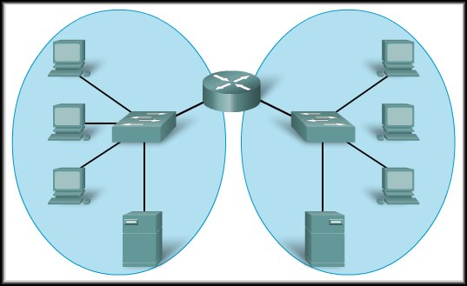
Performance
A
B
Routers block
broadcasts unless
specifically
configured to
forward them.
Replacing the
switch in the
diagram with a
router, creates two
separate IP sub-networks and two broadcast domains.
Broadcasts are now contained within each network.
X
X

Slide 31
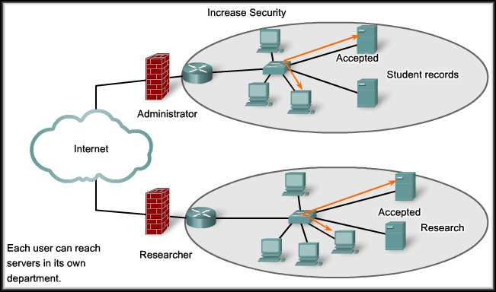
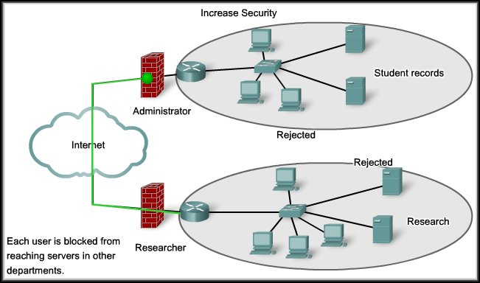
Security

Slide 32
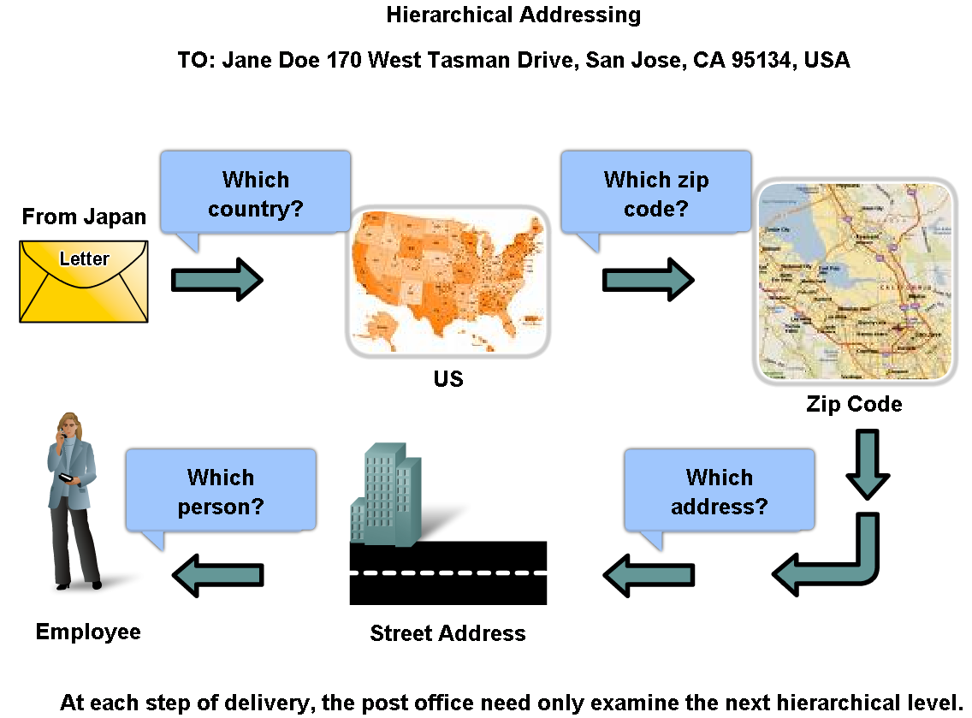
Grouping Devices into Networks and Hierarchical Addressing
Employee Name
Cisco Systems, Inc.
170 West Tasman Drive
San Jose, CA 95134
USA

Slide 33

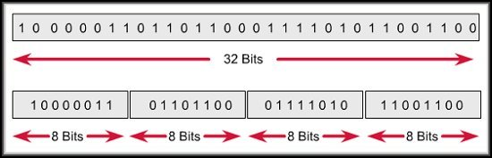

Dividing Networks from Networks
IP Version 4 addresses are 32 bits in length.
Divided into four separate groups of 8 bits each – 4 Octets.
Convert from binary to decimal – Dotted Decimal Notation.

Slide 34
Dividing Networks from Networks
An IP Version 4 address has two parts:
  Network number
  Host number
  The network portion of the address is the same for all hosts on the network.
  Each device is identified by a unique host portion.
This hierarchy means that routers only need to know the network portion – not the address of each individual host.

Slide 35
OSI Network Layer
Routing: How Data Packets Are Handled

Slide 36
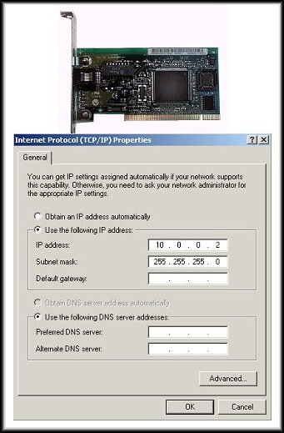
Address Types
Two address types:
  MAC address:
    Physical address of the host
    Burned in to the NIC
    Layer 2 address
  Network Address:
    Logical address of the host
    Assigned by network administrator
    Layer 3 address

Slide 37
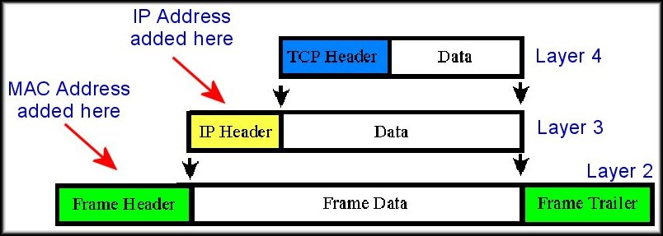
Each Host Has Two Addresses
Physical (MAC):
  The physical address uniquely identifies the host from all other hosts on all other networks at Layer 2.
  This is the address that is absolutely necessary to get the information into the host. The IP address by itself won't accomplish that.

Slide 38
Each Host Has Two Addresses
Logical (IP):
  The logical address uniquely identifies the host and the network to which it belongs at Layer 3.
  Routers base their decisions on the NETWORK PORTION of the IP address when determining the best path for the packet.

Slide 39
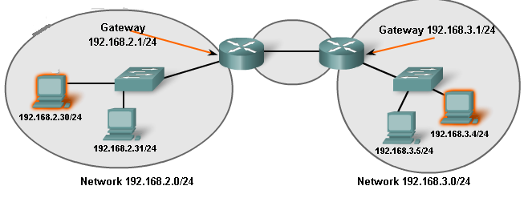
Default Gateway
Message for 192.168.3.4/24, Different network, send it to Default gateway.
Message for 192.168.2.31/24, Same network, send it direct.

Slide 40
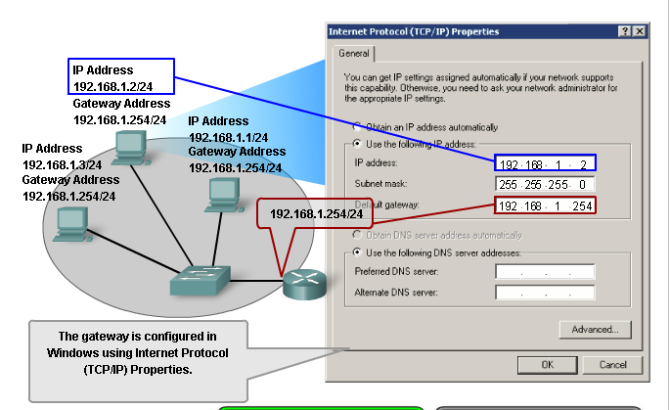
Default Gateway-The way out of our network

Slide 41
Default gateway
Each PC is configured with an IP address and a default gateway.
The default gateway is the IP address of a router port on the same network as the PC.
It is the router’s job to handle messages to other networks.
Each router port is on a different network and has a different IP address.

Slide 42
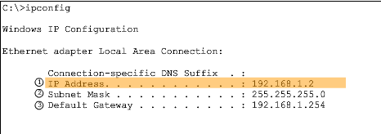
Confirming Gateway Settings
ipconfig or route commands

Slide 43

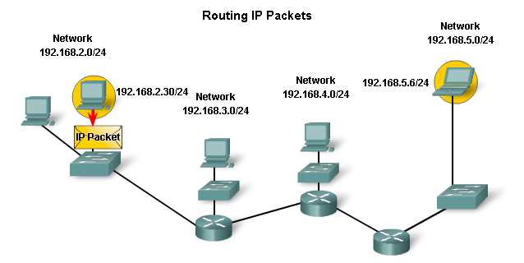







IP Packets-Carrying Data End to End
Notes:
No packet can be forwarded without a route. Whether the packet is originating in a host or being forwarded by an intermediary device, the device must have a route to identify where to forward the packet.

Slide 44
Route/Hops
No packet can be forwarded without a route.
Whether the packet is originating in a host or being forwarded by an intermediary device, the device must have a route to identify where to forward the packet.
A packet may pass through many routers on its journey.
The trip from one router to the next is called a hop and the next router is called the next hop router.

Slide 45
Routing Table
Each router has a routing table.
Stores information about Connected and Remote networks.
Connected networks are directly attached to one of the router interfaces.
Remote networks are networks that are not directly connected to the router.
  Can be manually configured on the router by the network administrator or learned automatically using dynamic routing protocols.

Slide 46
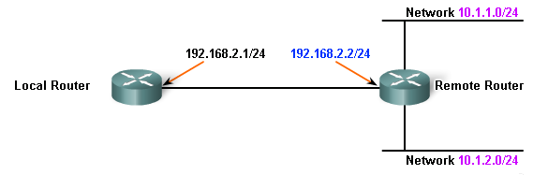

Routing Table
Network 192.168.3.0/24
192.168.2.0/24
C 192.168.3.0/24 is directly connected, FastEthernet 0/1

Slide 47
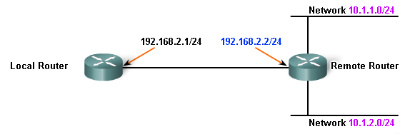
Routing Table
Routes in a routing table have four main features:
  Destination network
  Next-hop
  Metric
  Exit Interface
192.168.2.0/24
192.168.2.0/24

Slide 48
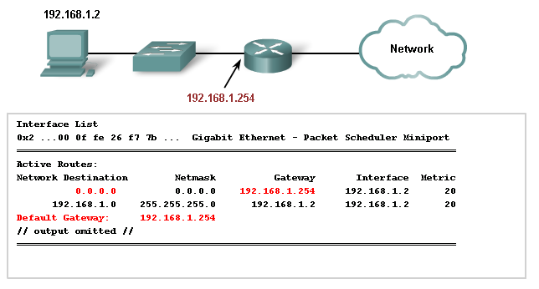
Host Routing Table
Using netstat -r, route, or route PRINT commands.
Other Commands
  route ADD
  route DELETE
  route CHANGE

Slide 49


Directly connected
The networks of the router’s own interfaces go into the routing table.

Slide 50
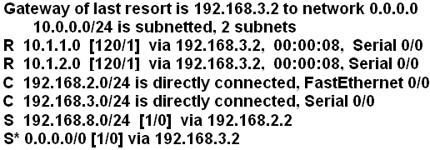
Routing table entries
Directly connected shown by C

Slide 51
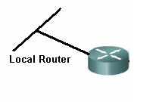
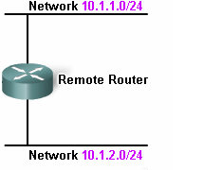


Directly Connected Routes
Network 192.168.3.0/24
Routing Table of Local Router :
Routing Table of Remote Router :
Gateway of last resort is not set.
C 192.168.3.0/24 is directly connected, FastEthernet 0/1
Gateway of last resort is not set.
C 10.1.1.0/24 is directly connected, FastEthernet 0/0
C 10.1.2.0/24 is directly connected, FastEthernet 0/1

Slide 52
Other networks
Routes to other networks can be configured by an administrator (static routes)
Or they can be learned from another router using a routing protocol (dynamic routes)
A router can have a default route. Packets for unknown networks go on this route instead of being dropped.

Slide 53
Routing Table Entries: Dynamic Routes
Learned from another router using RIP routing protocol, shown by R

Slide 54
Dynamic Routes
Gateway of last resort is not set.
C 10.1.1.0/24 is directly connected, FastEthernet 0/0
C 10.1.2.0/24 is directly connected, FastEthernet 0/1C 192.168.2.0/24 is directly connected, FastEthernet 0/2
Network 192.168.3.0/24
Gateway of last resort is not set.
C 192.168.3.0/24 is directly connected, FastEthernet 0/1
C 192.168.2.0/24 is directly connected, FastEthernet 0/0
Routing Table of Local Router :
Routing Table of Remote Router :
Gateway of last resort is not set.
C 192.168.3.0/24 is directly connected, FastEthernet 0/1
C 192.168.2.0/24 is directly connected, FastEthernet 0/0
Gateway of last resort is not set.
C 10.1.1.0/24 is directly connected, FastEthernet 0/0
C 10.1.2.0/24 is directly connected, FastEthernet 0/1
C 192.168.2.0/24 is directly connected, FastEthernet 0/2

Slide 55
Dynamic Routes
Network 192.168.3.0/24
Routing Table of Local Router :
Routing Table of Remote Router :
Gateway of last resort is not set.
10.0.0.0/24 is subnetted, 2 subnets
R 10.1.1.0[120/1] via 192.168.2.2,00:00:08, FastEthernet 0/0
R 10.1.1.0[120/1] via 192.168.2.2,00:00:08, FastEthernet 0/0
C 192.168.3.0/24 is directly connected, FastEthernet 0/1
C 192.168.2.0/24 is directly connected, FastEthernet 0/0
Gateway of last resort is not set.
R 192.168.3.0[120/1] via 192.168.2.1,00:00:20, FastEthernet 0/0
C 10.1.1.0/24 is directly connected, FastEthernet 0/0
C 10.1.2.0/24 is directly connected, FastEthernet 0/1
C 192.168.2.0/24 is directly connected, FastEthernet 0/2

Slide 56
Routing table entries: Static Routes
Static, configured by administrator, shown by S
Static, configured by administrator, shown by S

Slide 57

Static Routes
Network 192.168.3.0/24
Routing Table of Remote Router :
Routing Table of Remote Router :
Gateway of last resort is not set.
R 192.168.3.0[120/1] via 192.168.2.1,00:00:20, FastEthernet 0/0
C 10.1.1.0/24 is directly connected, FastEthernet 0/0
C 10.1.2.0/24 is directly connected, FastEthernet 0/1
C 192.168.2.0/24 is directly connected, FastEthernet 0/2
Gateway of last resort is not set.
C 10.1.1.0/24 is directly connected, FastEthernet 0/0
C 10.1.2.0/24 is directly connected, FastEthernet 0/1
C 192.168.2.0/24 is directly connected, FastEthernet 0/2
S 192.168.3.0[1/0] via 192.168.2.1

Slide 58

Default Routes
Network 192.168.3.0/24
Internet
ISP
Routing Table of Remote Router :
Gateway of last resort is 192.168.2.1 to network 0.0.0.0.
R 192.168.3.0[120/1] via 192.168.2.1,00:00:20, FastEthernet 0/0
C 10.1.1.0/24 is directly connected, FastEthernet 0/0
C 10.1.2.0/24 is directly connected, FastEthernet 0/1
C 192.168.2.0/24 is directly connected, FastEthernet 0/2
S* 0.0.0.0/0 [1/0] via 192.168.2.1

Slide 59
Routing Table Entries: Default Routes
Default, configured by administrator, shown by S*

Slide 60
Routing protocols
Routers learn routes from each other and put them in their routing tables.
A routing protocol is the set of rules they use to swap information.
These routes are dynamic routes

Slide 61
Static routes Dynamic routes
Entered by administrator
Time consuming, different for each router
Must be updated if routes change
Little processing
No bandwidth used
Gives nothing away
Learned from other routers
Start the protocol then it runs by itself
Automatically updates when routes change
More processing
Uses bandwidth
Gives away information

Slide 62
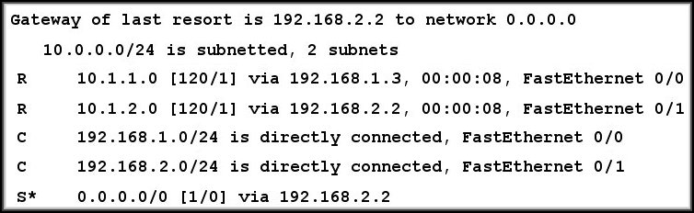

Packet Forwarding: Route Found
Data for Host 10.1.2.2 / 24
L2 | IP | TCP | DATA | L2
Network 10.1.1.0
IP | TCP | DATA
Network 10.1.2.0
IP Address 10.1.2.2 is on network 10.1.2.0
L2 | IP | TCP | DATA | L2

Slide 63
Packet Forwarding: Default Route
Data for Host 207.1.1.1 / 24
L2 | IP | TCP | DATA | L2
Network 10.1.1.0
IP | TCP | DATA
Network 10.1.2.0
IP Address 207.1.1.1 is on network 207.1.1.0
L2 | IP | TCP | DATA | L2

Slide 64
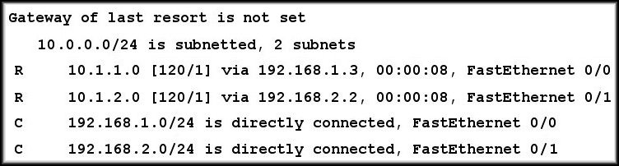
Packet Forwarding: Route Not Found
?
Data for Host 207.1.1.1 / 24
L2 | IP | TCP | DATA | L2
Network 10.1.1.0
IP | TCP | DATA
Network 10.1.2.0
IP Address 207.1.1.1 is on network 207.1.1.0

Slide 65


